Slide 1


Machine Learning for Downtime Prediction
STAT606 Practical Assignment
Binary Classification: Maintenance Requirement Prediction
By Yanga Ndamase (226029024) & Mawanda Mbaza (226024595

Slide 2
Raw Downtime Data
Data Cleaning,
Target Definition & Preprocessing
Feature Engineering
Machine learning Techniques
Models evaluation & Best Model Selection
Feature Importance
Conclusion
Contents flowchart
From raw downtime data to model evaluation

Slide 3


Brief introduction to the data and problem
Dataset
We are using the iportal_downtimes dataset from manufacturing operations.
The dataset contains machine downtime events (features) from PLC in roborts such as:
downtime duration
fault duration
plant
department
area
downtime type
failure reason
machine messages
timestamps
Each row represents a machine downtime incident.
This will help:
reduce production downtime
prioritize maintenance teams
improve operational efficiency
Business Problem
The objective is to predict whether machine downtime/failures require maintenance using EMEA plants historical downtime logs.
Goal: Reduce unplanned downtime through early identification of maintenance needs.
Binary classification problem: MaintenanceRequired (0/1)
Target Variable:
MaintenanceRequired
Mantainance Required | Target
Yes | 1
No | 0

Slide 4
Data Understanding, Preprocessing & Feature Engineering
Duplicate removal: unique(df) used to eliminate repeated downtime records & bias in model learning.
Handled missing numeric values: imputed using median (robust to outliers).
Handled missing categorical values: replaced with 'Unknown' category so model can still learn from them.
Fixed NaN and infinite values before modelling our data in H2O environment
High-cardinality identifiers removed (e.g., DowntimeId) to reduce noise.
Removed leakage variables used in target construction (e.g. DowntimeType), Class order was enforced (levels = c("0","1")) ,Numeric conversion + median imputation were also used.
Remove identifier columns that do not contribute to prediction
Feature Engineering (Purpose: Improve model ability to capture operational behaviour patterns)
Target creation: based on median downtime threshold + failure keywords.
New features: Hour extracted from timestamp, DayOfWeek derived from DowntimeStartDatetime.
EmergencyFlag created using keyword detection (emergency, critical, urgent) from DowntimeDescription

Slide 5
4. Machine Learning Techniques
Three classification techniques were applied are as follows:
Decision Tree (interpretable rule-based model)
Implemented using Random Forest with a small number of trees for stability
rpart was used for visual interpretation of tree structure & to display fitted tree information
Logistic Regression (linear baseline model)
To captures linear relationships in downtime behaviour
Naive Bayes (probabilistic independence model)
For assuming conditional independence between predictors in our model

Slide 6
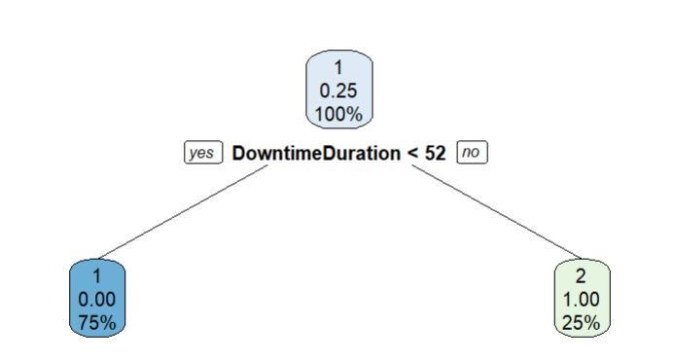
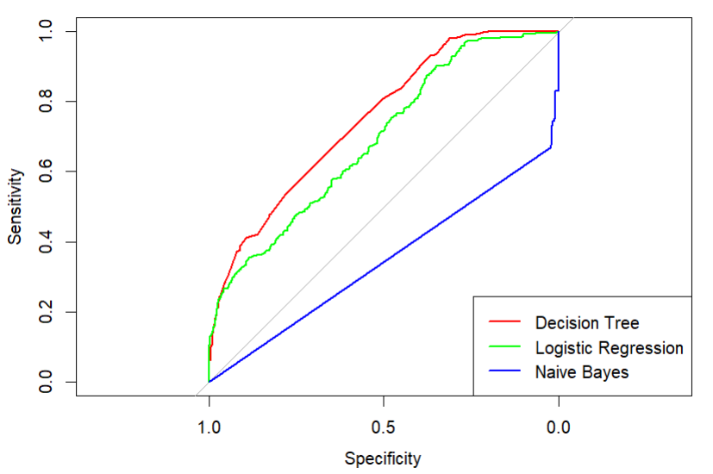
Model Evaluation & Results
Used 70:30 split ensuring class representation.
Best Model Selection :
Evaluation metric: AUC (Area Under Curve) - We use AUC instead of F1 because : - downtime data is often imbalanced
The Decision Tree achieved the highest AUC - demonstrating the strongest predictive performance on the held‑out test set.
Logistic Regression showed lower performance, as its linear structure limited its ability to capture non‑linear and threshold‑based patterns in maintenance behaviour.
Naïve Bayes performed poorest - likely due to violations of the conditional independence assumption after data cleaning and leakage removal.
Decision Tree
Notes:
Based on AUC evaluated on a held‑out test set, the
Decision Tree achieved the best predictive performance (AUC ≈ 0.7495) & shows the strongest ROC performance, indicating the strongest overall discriminative ability.
Logistic Regression showed moderate performance, constrained by its linear modelling assumptions. In contrast,
Naïve Bayes exhibited weak generalization after data cleaning and leakage removal, suggesting that its conditional independence assumption was not well suited to the final feature set.
High sensitivity achieved with better separation of classes.
Consequently, feature importance and key drivers of maintenance were interpreted primarily using the Decision Tree and supported by Logistic Regression. The results further demonstrate that feature engineering substantially improved predictive power, with downtime severity, time‑based patterns, and operational context emerging as the primary drivers of maintenance requirements.

Slide 7
Model Evaluation & Results contin…
AUC values:
Decision Tree = 0.7495 (BEST)
Logistic Regression = 0.6906
Naive Bayes = 0.3452
Logistic Regression
AUC = 0.69 → lower than DT
Predicts mostly class 1 (maintenance)
Conclusion:
Likely underfitting (high bias)
Cannot capture complex downtime patterns
Interpretation
Decision Tree (Best Model)
AUC = 0.75 → moderate performance
The model is not extremely high (not close to 1)
Conclusion:
The model is not overfitting,
It is generalizing reasonably well
Slight underfitting may still be present, due to:
- shallow tree (max_depth = 5, ntrees = 8)
- Very simple splitting rule:
DowntimeDuration < 51.5 → class 0
DowntimeDuration ≥ 51.5 → class 1
This shows the model is too simple → high bias
Naive Bayes
AUC = 0.35 → very poor
Probabilities are almost zero everywhere
Predicts same class repeatedly
Conclusion:
Severe underfitting
Model assumptions (independence) are violated
Notes:
The Decision Tree model achieved the highest AUC of 0.7495, indicating moderate predictive performance and reasonable generalization.
There is no strong evidence of overfitting, as the model is relatively simple (limited tree depth and number of trees).
However, the simple structure suggests some underfitting may be present, indicating high bias and an inability to fully capture complex downtime patterns.
The Logistic Regression model also shows signs of underfitting due to its lower AUC and linear assumptions.
The Naive Bayes model performs poorly (AUC = 0.3452), indicating severe underfitting, likely due to its strong independence assumptions. Overall, the models exhibit low variance but moderate to high bias, particularly for Logistic Regression and Naive Bayes.

Slide 8
Feature Importance
Feature Importance is used AFTER model selection to:
Extracted from the best-performing model (AUC)
Identify top predictors of MaintenanceRequired
Extract the 5 most influential variables
Explain why the model predicts maintenance
Top predictive features (Decision Tree):
DowntimeDuration ((MOST IMPORTANT)
Hour
EditTimestamp
GaeWaterfall
ControlledDowntime
Feature | Importance
DowntimeDuration | 23.66%
Hour | 20.20%
EditTimestamp | 14.45%
GaeWaterfall | 9.96%
ControlledDowntime | 9.08%
Notes:
The feature importance results show that DowntimeDuration is the most influential variable in predicting maintenance requirements, indicating that longer downtime events are strongly associated with maintenance needs.
Other important features include Hour and EditTimestamp, suggesting that the timing of downtime events also plays a significant role.
Operational features such as GaeWaterfall and ControlledDowntime further contribute to the prediction. However, the dominance of DowntimeDuration and the simple structure observed in the decision tree indicate that the model relies heavily on a single feature, which may result in underfitting and limit the model’s ability to capture more complex relationships in the data.

Slide 9
Conclusion

